Slide 1


Cloud Computing
Opportunities
Sunil Karwasra
Yusata Infotech Private Limited
17 June 2020

Slide 2
Agenda
→ Cloud Technologies
→ Need for Cloud - Data Source and Industry 4.0
→ Cloud Managed Services
    →Cloud Provisioning
    →Cloud Maintenance and SLAs
    →Billing, Access and, Security
    →Development and DevOps
    →Cloud Integrations
    →Big Data and Analytics
    →IOT and Data Streaming
→ Questions

Slide 3
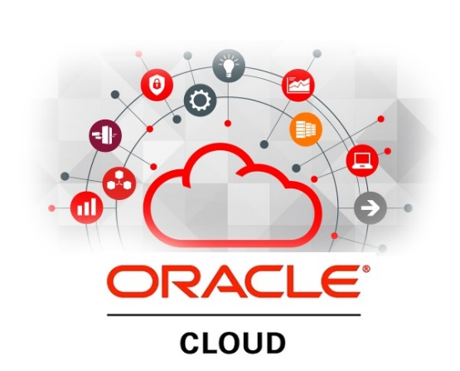
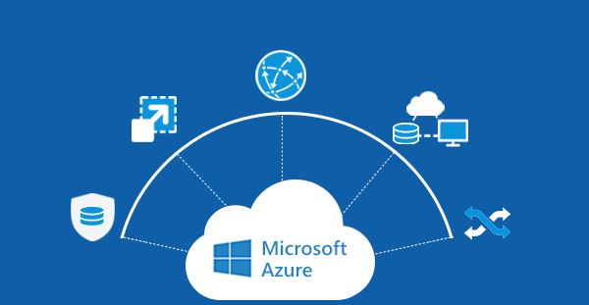
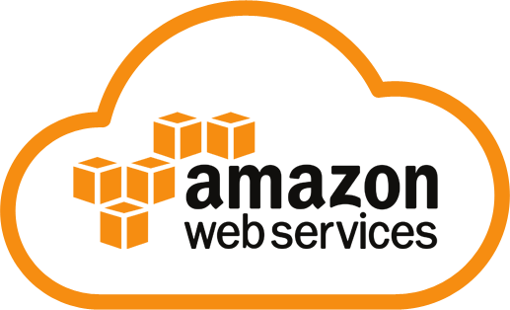
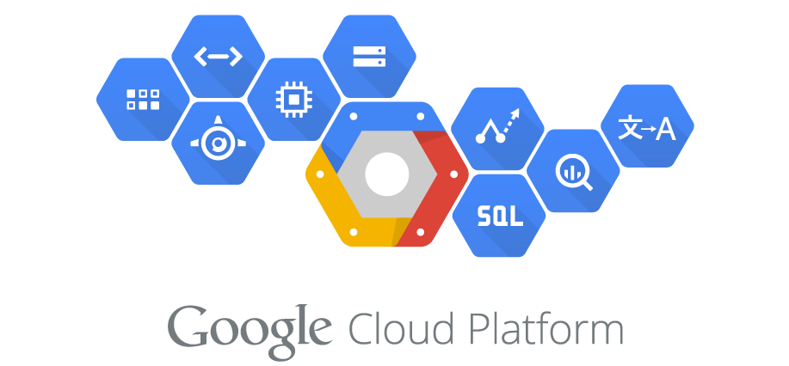
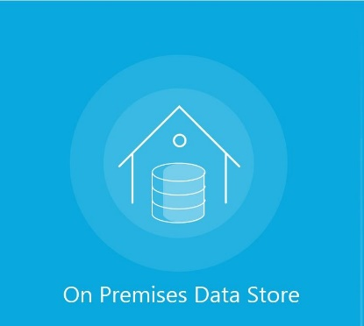
Slide 2
Cloud Technologies

Slide 4


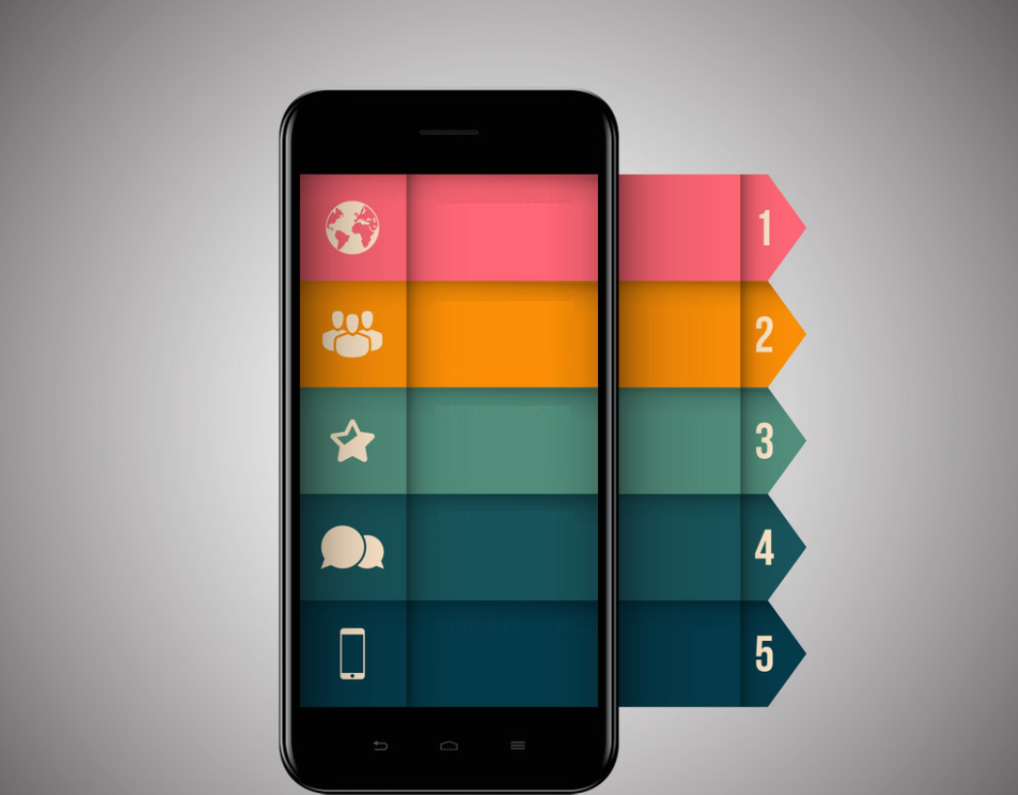
Slide 2
Data sources - generates enormous data
Social Media
Web based Apps
Mobile Apps
Posts
Likes/Shares
Views
Campaigns/Reach
Sign-Up/Sign-In
Demographics
Actions and times
Uptime monitoring
Location Data
Usage Stats
Screen Time
Interests

Slide 5
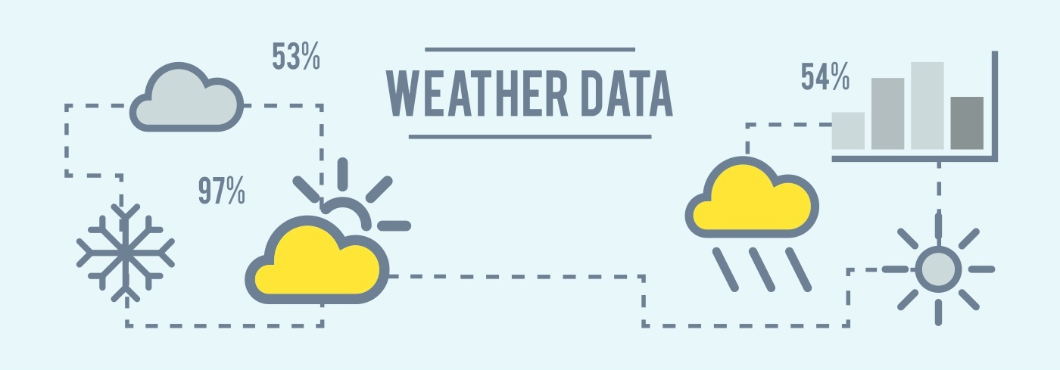
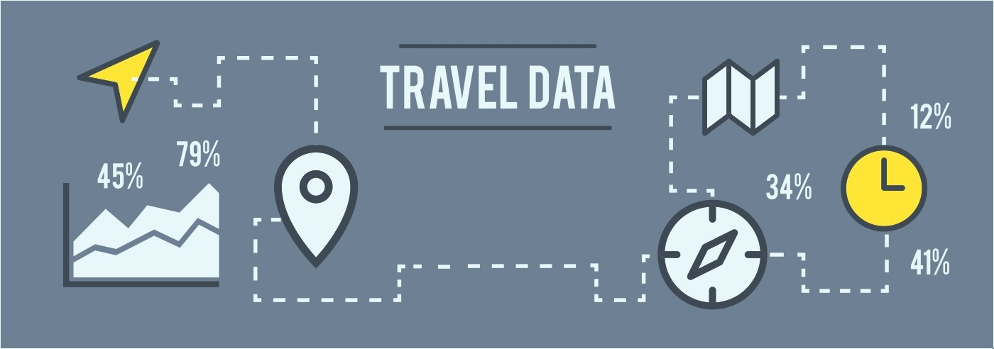
Slide 2
Data sources - generates enormous data
Temperature
Humidity
Precipitation
Sun-rise/Sun-set time
Location
Transit times
Directions
Delays

Slide 6
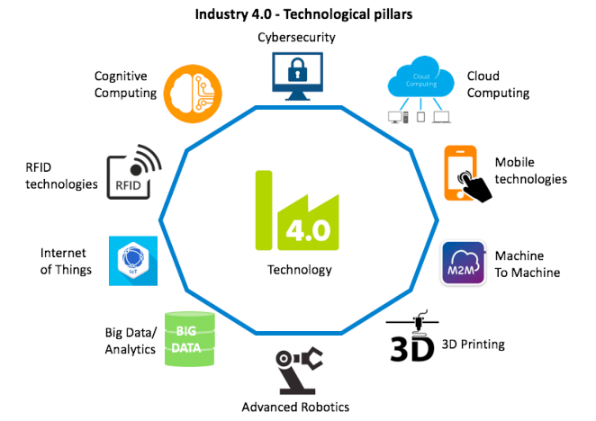
Industry 4.0 is here – Thanks to these disruptive technologies
Astonishing rise in data volumes, computational power, and connectivity
Emergence of analytics and business-intelligence capabilities
New forms of human-machine interaction
(touch interfaces and augmented-reality systems)
Improvements in transferring digital instructions to the physical world
(advanced robotics and 3-D printing)

Slide 7
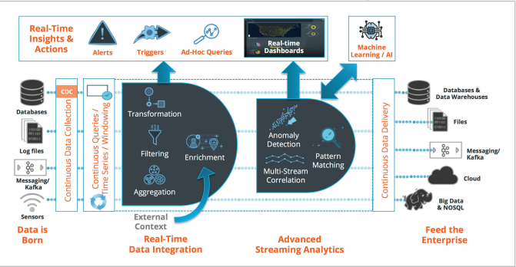

Data Phases
IoT benefit to factories by 2025
5

Slide 8

Real-time Equipment Monitoring
Provides Significant Advantages
Instant knowledge of Industry KPIs
Constantly monitor equipment health to ensure uptime
Predict equipment maintenance, reduce unplanned downtime Integrate insights with
business processes (MES, SCM)

Slide 9

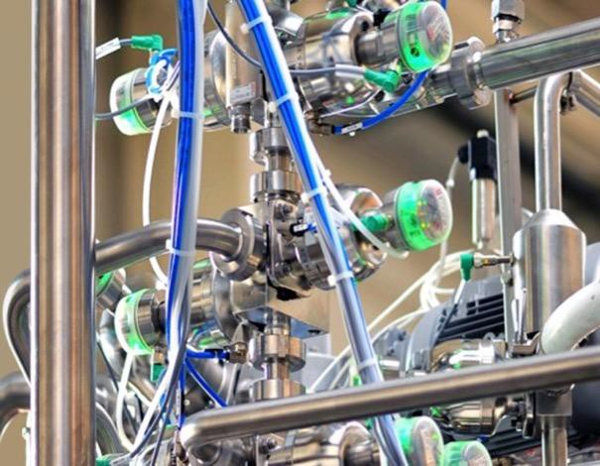

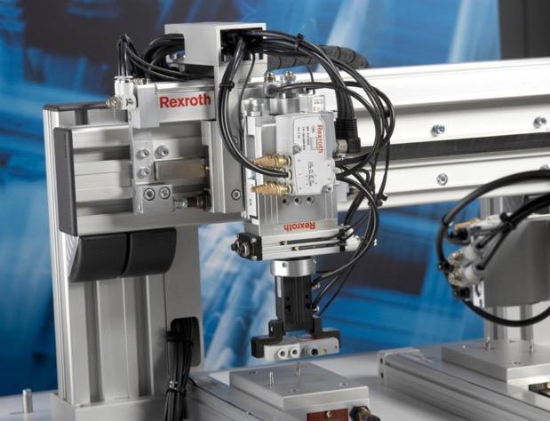

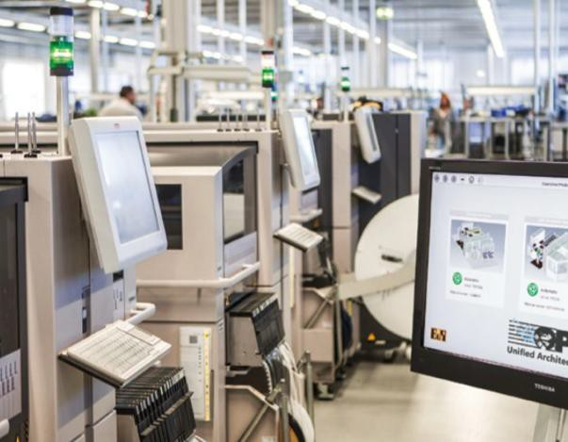

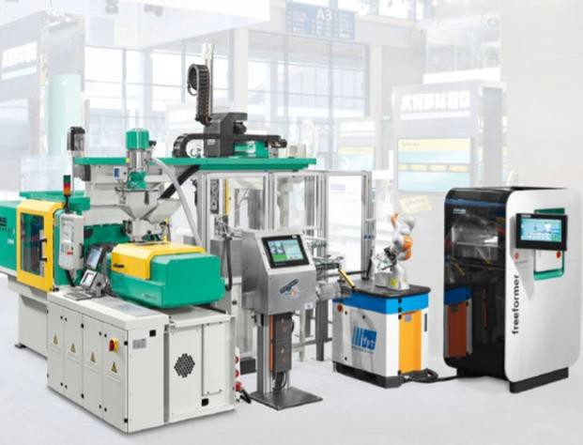

IoT Use cases
Pharma Manufacturing
Benefits:
Reduced scrap rate
Improved machine health tracking
Increased uptime
High Tech Manufacturing
Benefits:
Increased capacity utilization
Reduced unplanned downtime
Consumer Electronics
Plastic Manufacturing
Benefits:
Benefits:
Improved delivery
On-time delivery of multi-variant individualized products
Increased line utilization
Reduced scrap
Copyright © 2017, Oracle and/or its affiliates. All rights reserved. |
7

Slide 10
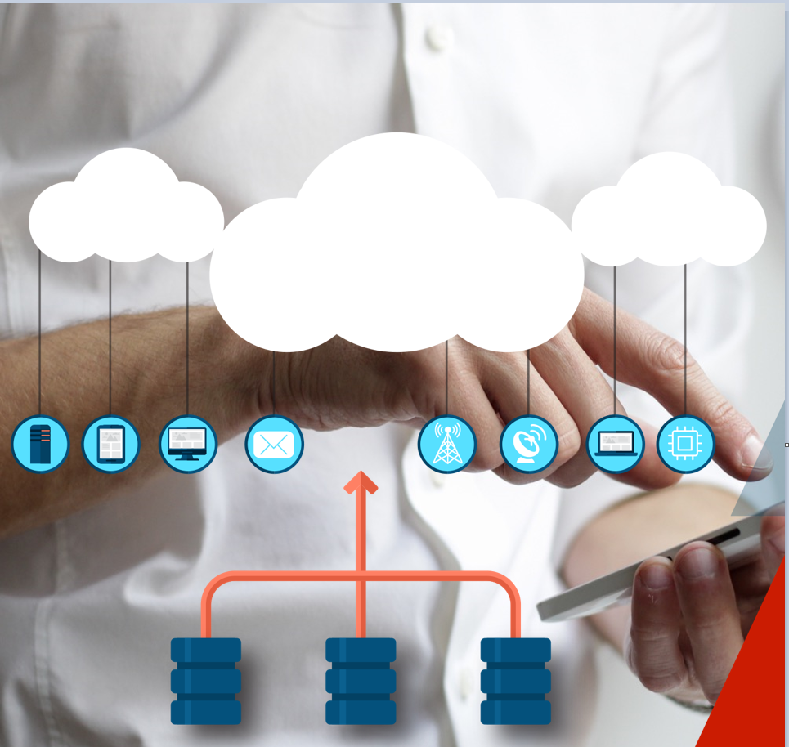
Cloud Managed Services
    →Cloud Provisioning
    →Cloud Maintenance and SLAs
    →Billing, Access and, Security
    →Development and DevOps
    →Cloud Integrations
    →Big Data and Analytics
    →IOT and Data Streaming
IoT benefit to factories by 2025
5

Slide 11
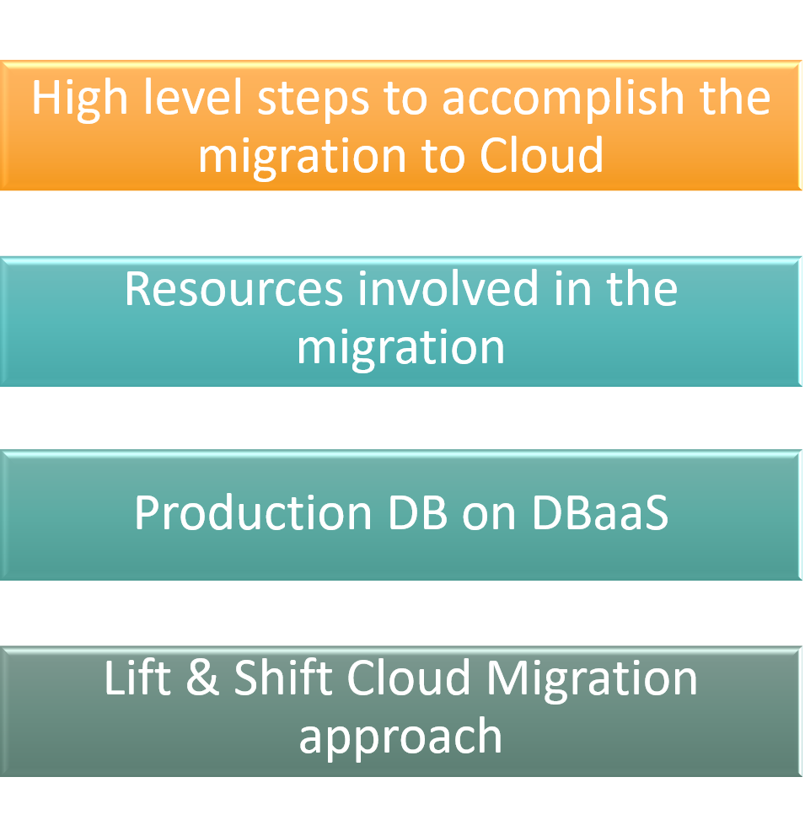
Cloud Managed Services
    →Cloud Provisioning
    →Cloud Maintenance and SLAs
    →Billing, Access and, Security
    →Development and DevOps
    →Cloud Integrations
    →Big Data and Analytics
    →IOT and Data Streaming
IoT benefit to factories by 2025
5

Slide 12
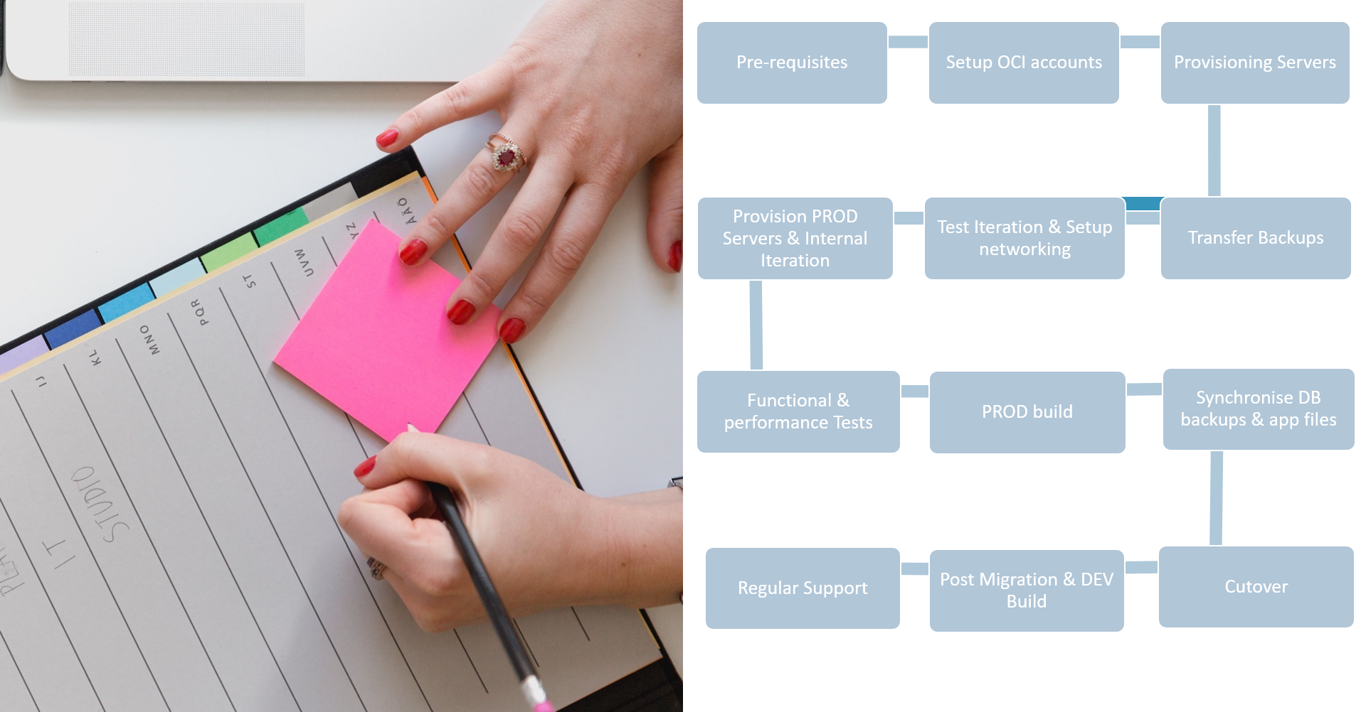
Cloud Managed Services
    →Cloud Provisioning
    →Cloud Maintenance and SLAs
    →Billing, Access and, Security
    →Development and DevOps
    →Cloud Integrations
    →Big Data and Analytics
    →IOT and Data Streaming
5

Slide 13
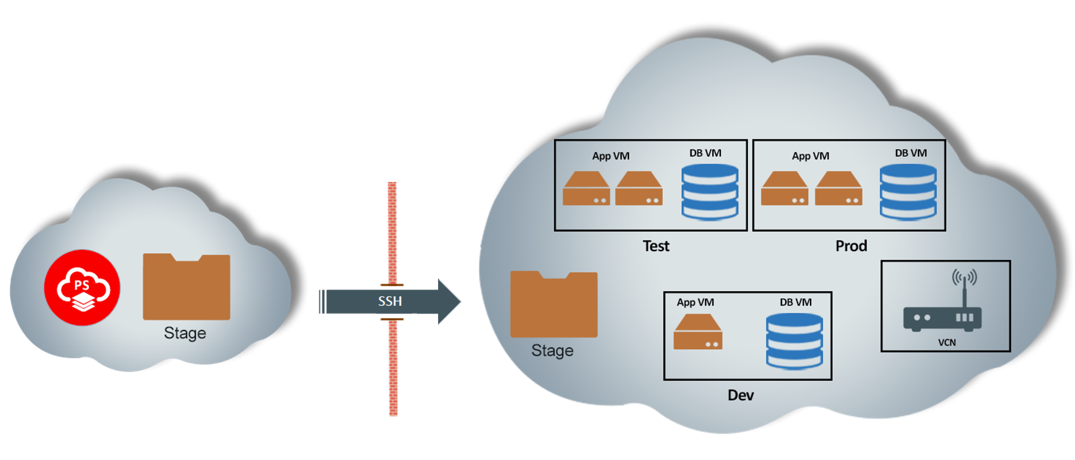
Cloud Components
5

Slide 14
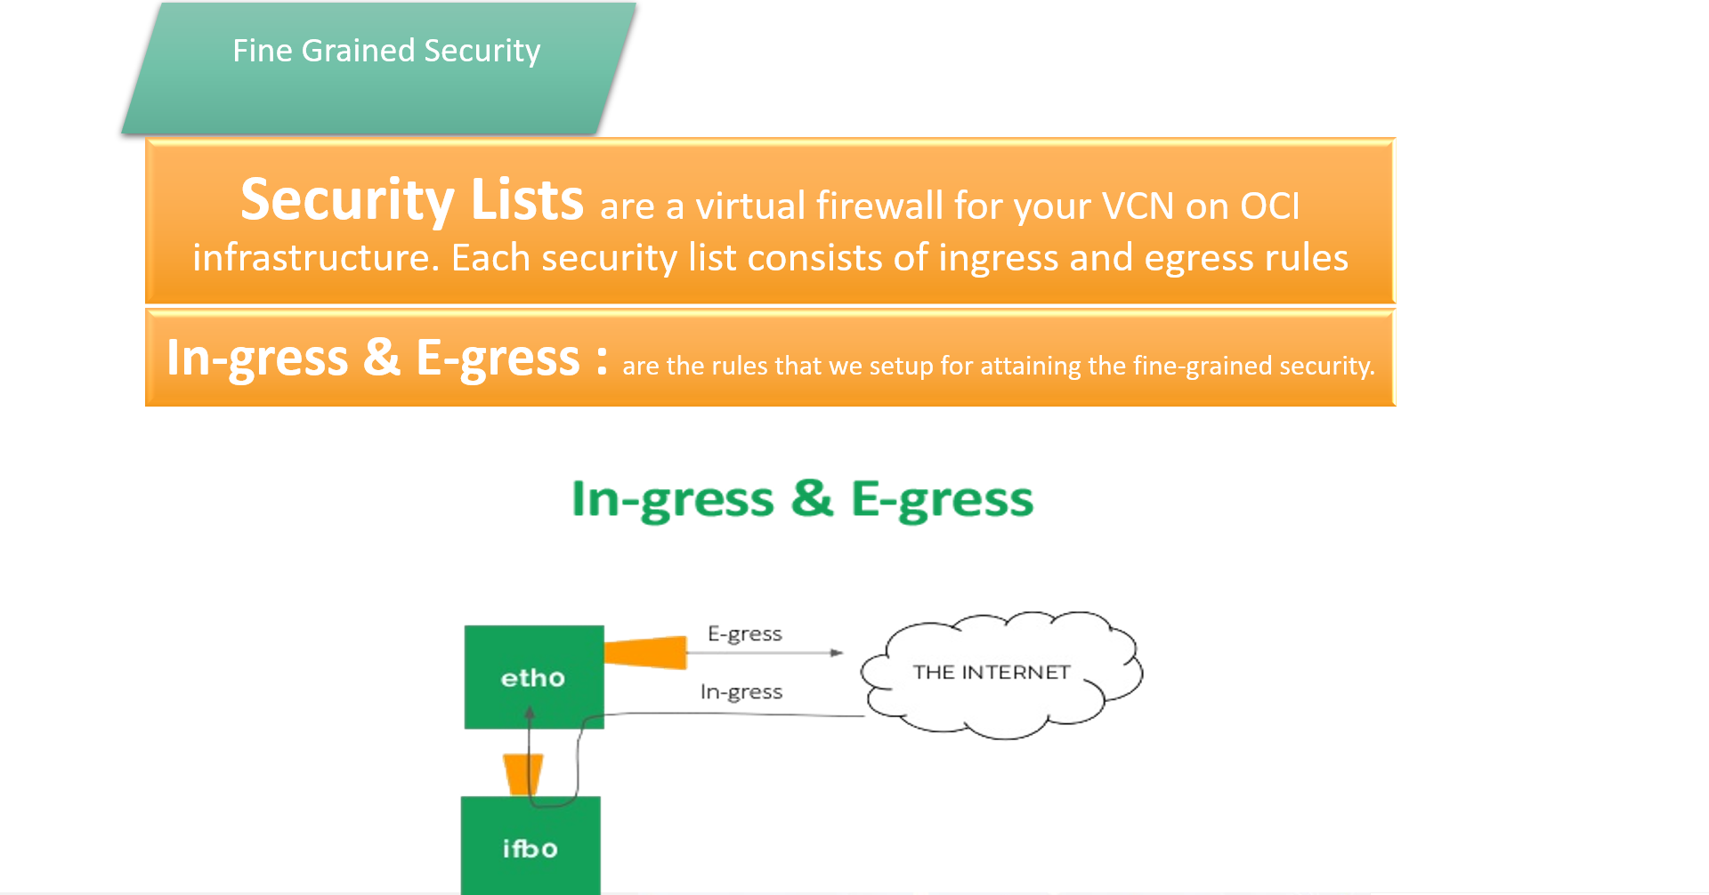
Cloud Components
5

Slide 15
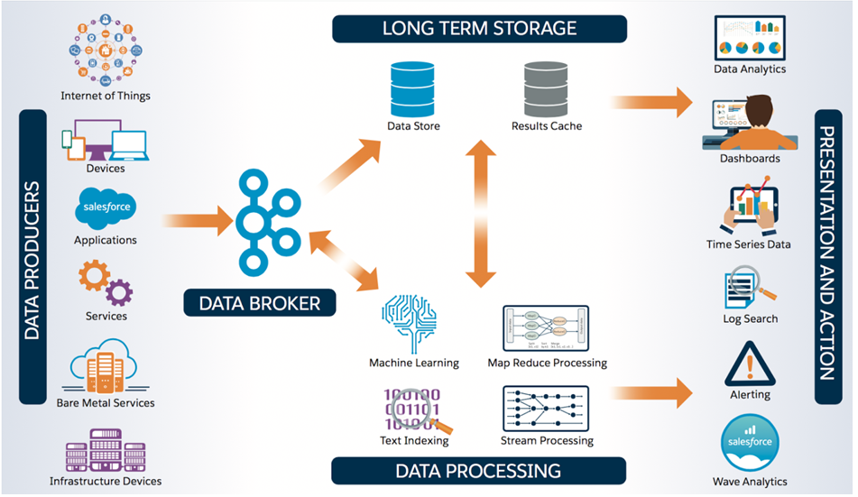
5

Slide 16
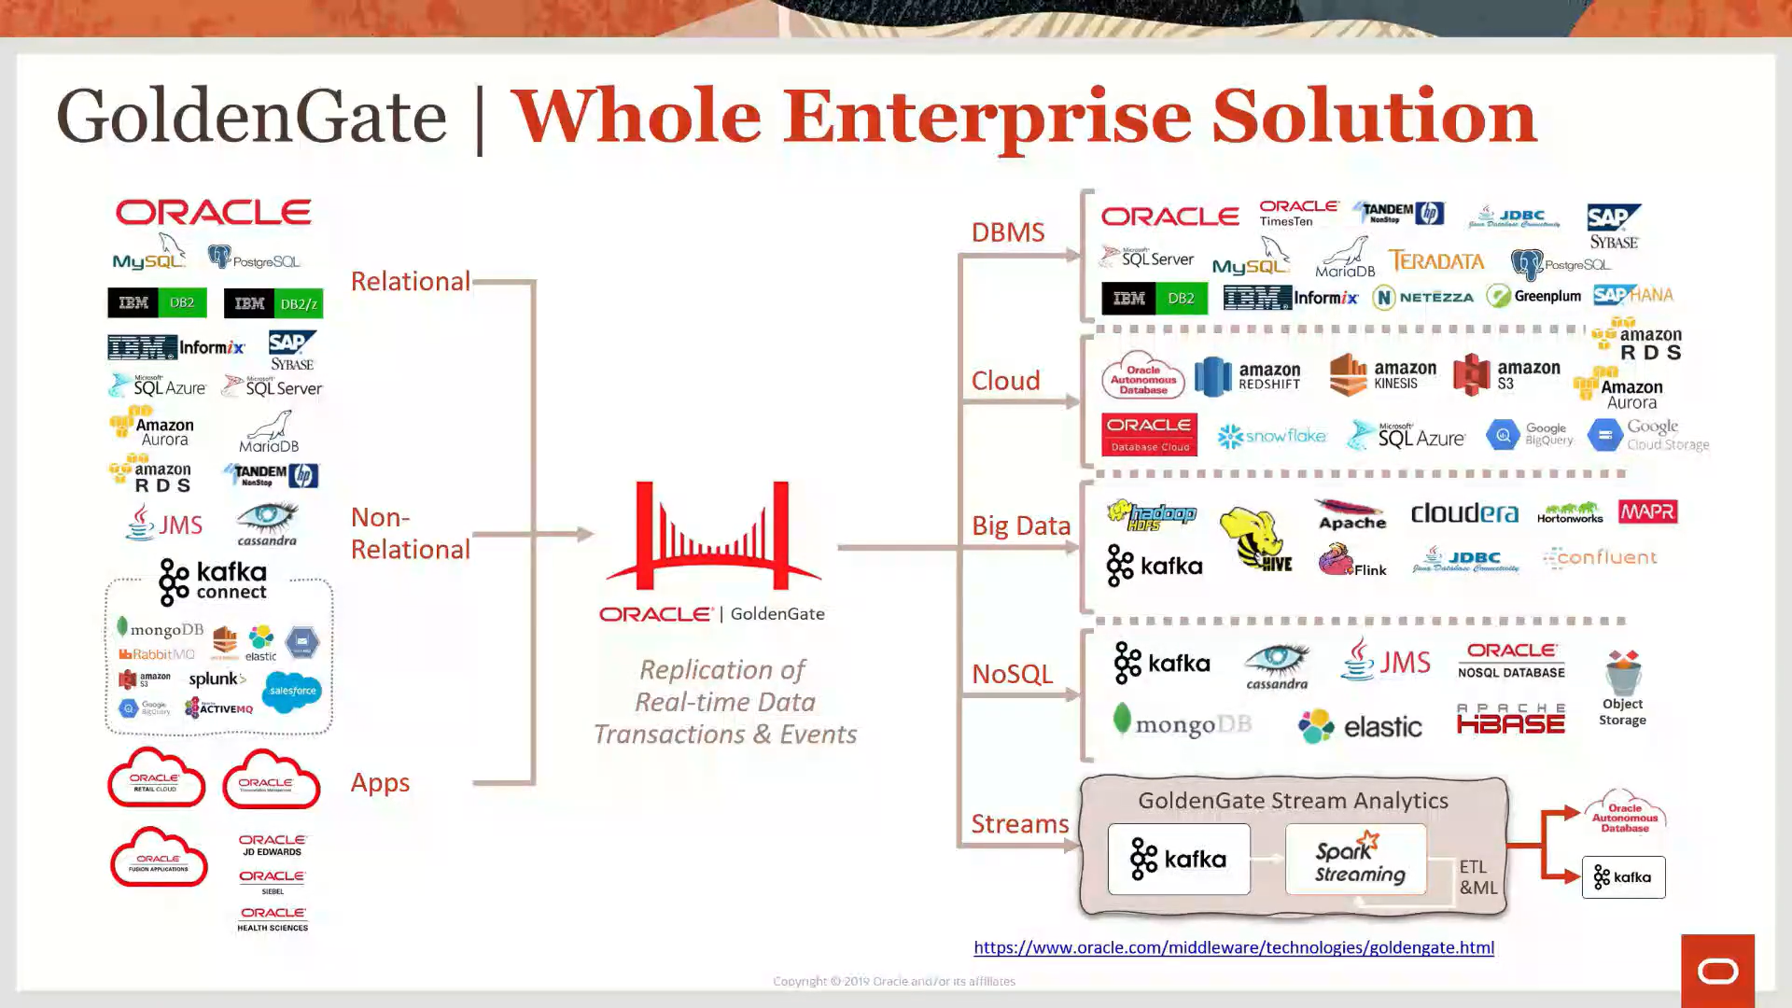
5

Slide 17
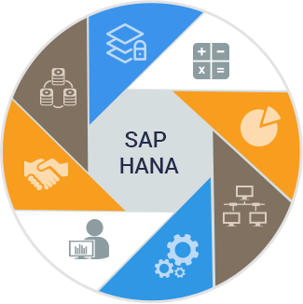

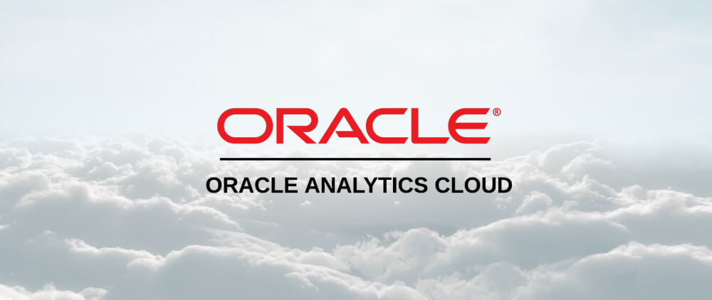
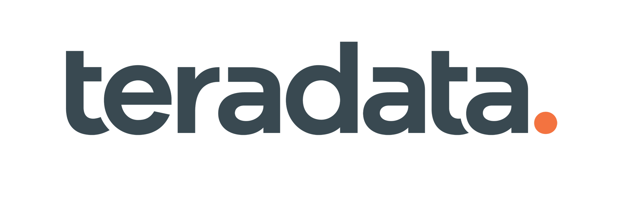
Slide 4
Analytics Platforms

Slide 18
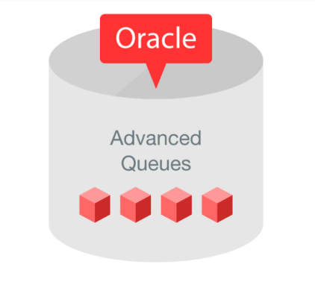

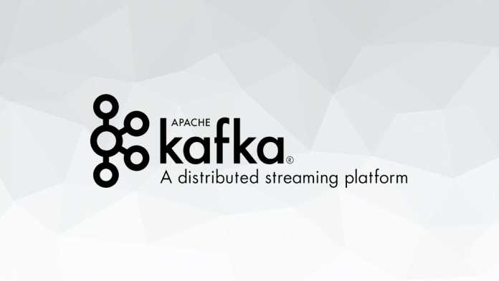



Slide 4
Data Streaming
Technologies

Slide 19
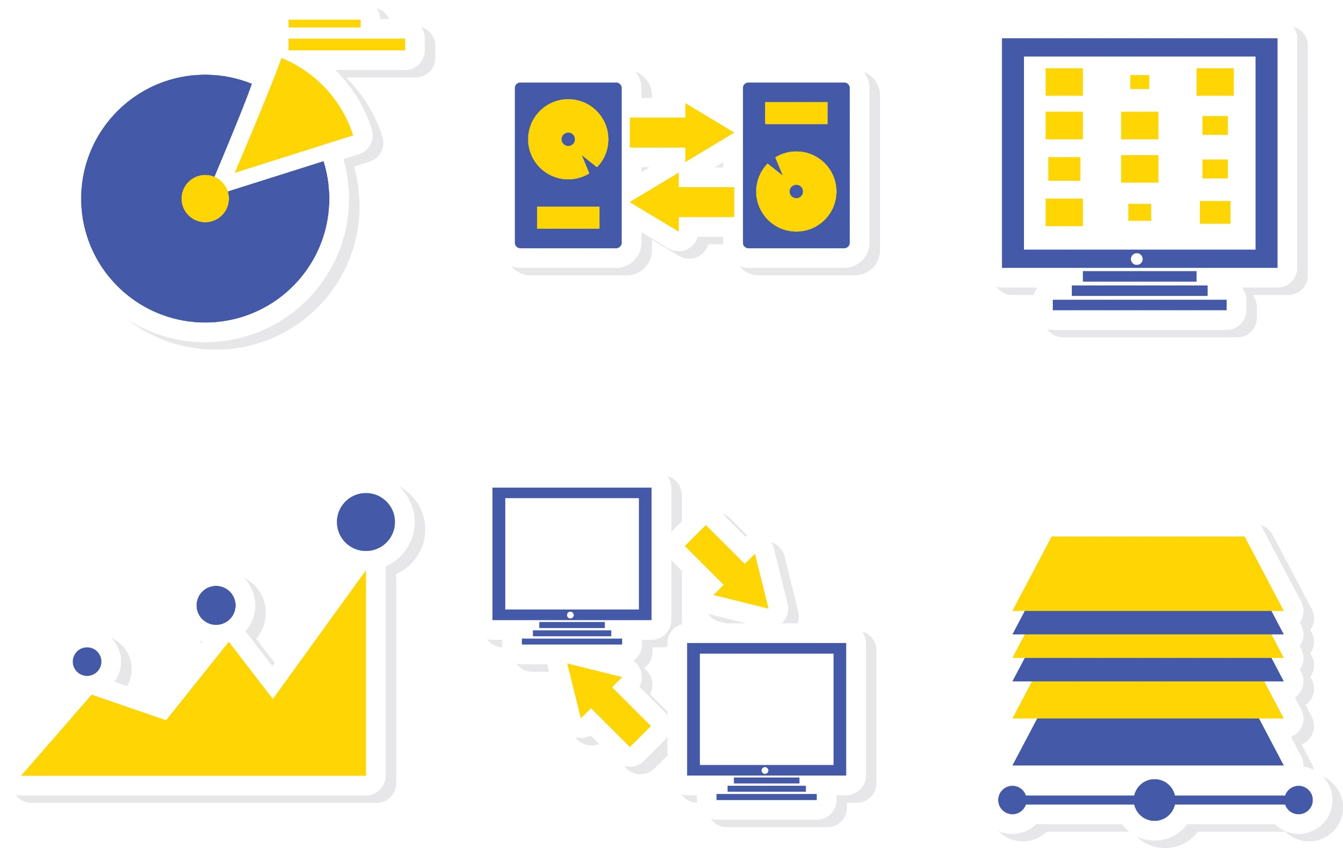
Slide 11
Thank you

